Slide 1
AI in Mathematics
Lecture 5
Deep Learning in Mathematics
Bar-Ilan University
Nebius Academy | Stevens Institute of Technology
April 22, 2025

Slide 2
About This Course
1 week: Intro
2 weeks: Classic ML
2 weeks: Deep Learning in Mathematics
3 weeks: Math as an NLP problem (LLMs etc.)
3 weeks: Reinforcement Learning (RL) in Math
1 week: Advanced AI topics
1 week: Project Presentations

Slide 3
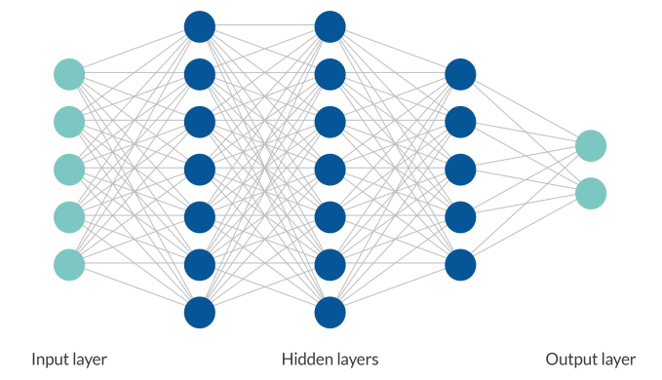
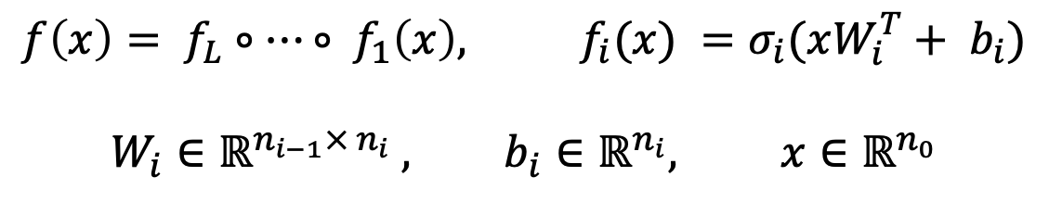
Neural Network
$$f\left(x\right)= f_{L}∘…∘ f_{1}\left(x\right), f_{i}(x) =σ_{i}(xW_{i}^{T}+ b_{i})$$
$$W_{i}∈ℝ^{n_{i−1}× n_{i}} , b_{i}∈ℝ^{n_{i}}, x∈ℝ^{n_{0}}$$

Slide 4
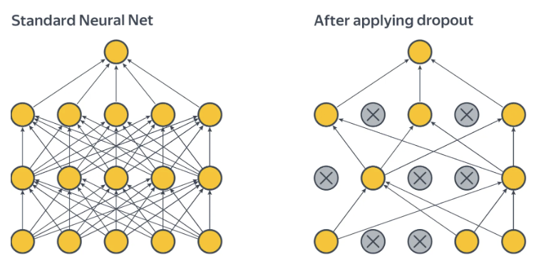
Dropout

Slide 5
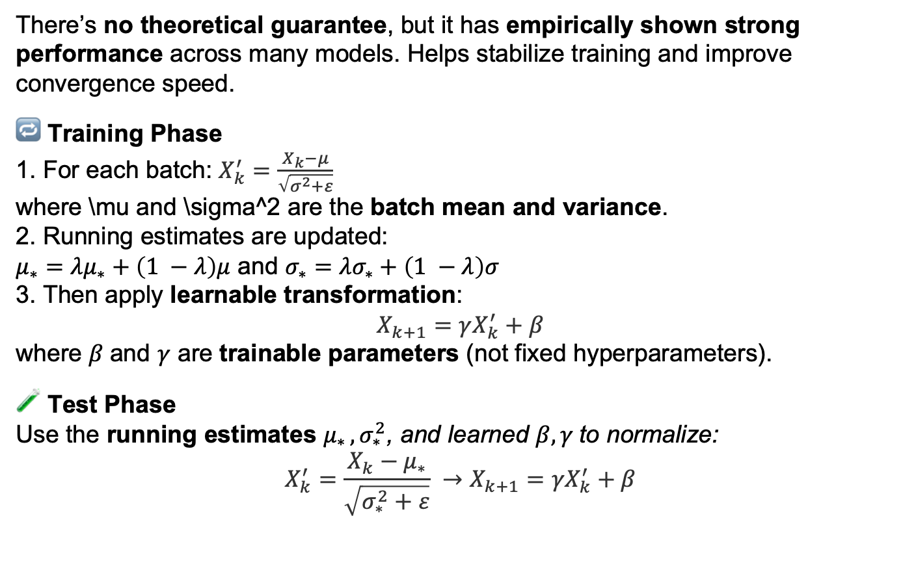
BatchNorm
Linear layer
BatchNorm
Activation
There’s no theoretical guarantee, but it has empirically shown strong performance across many models. Helps stabilize training and improve convergence speed.
🔁 Training Phase
For each batch: $X_{k}^{′}=\frac{X_{k}−μ}{\sqrt{σ^{2}+ε}}$
where \mu and \sigma^2 are the batch mean and variance.
2. Running estimates are updated:
$μ_{∗}={λμ}_{∗}+\left(1 −λ\right)μ$ and $σ_{∗}={λσ}_{∗}+\left(1 −λ\right)σ$
3. Then apply learnable transformation:
$$X_{k+1}=γX_{k}^{′}+β$$
where $β$and $γ$ are trainable parameters (not fixed hyperparameters).
🧪 Test Phase
Use the running estimates $μ_{∗ }, σ_{∗}^{2}$, and learned $β, γ$to normalize:
$$X_{k}^{′}=\frac{X_{k}−μ_{∗}}{\sqrt{σ_{∗}^{2}+ε}} →X_{k+1}={γX}_{k}^{′}+β$$

Slide 6
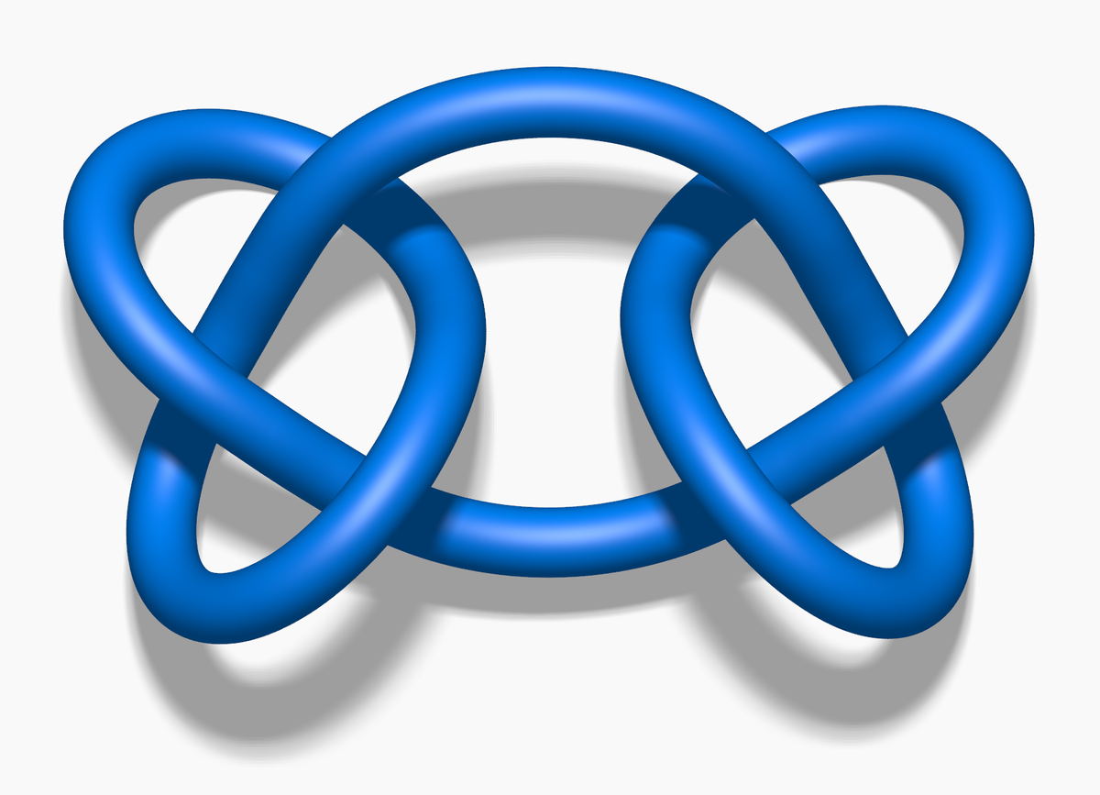
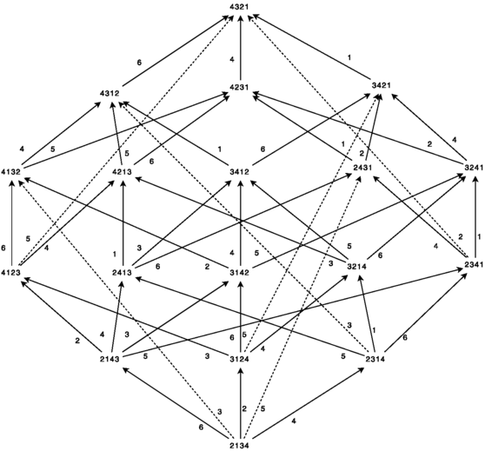
Advancing mathematics by guiding human intuition with AI (2021)
Representation
theory
Representation
theory
Knot Theory

Slide 7
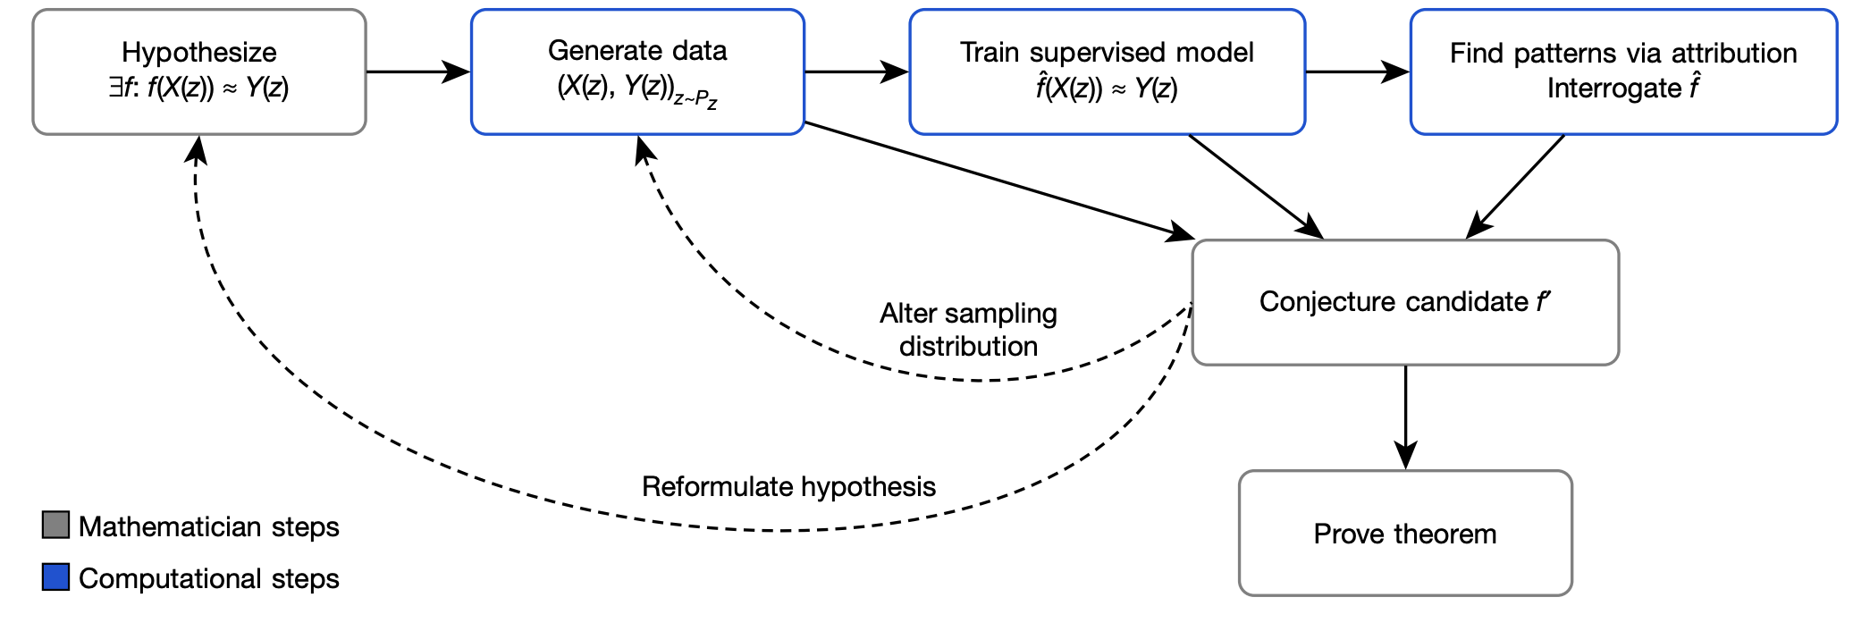
General framework suggested by the authors

Slide 8
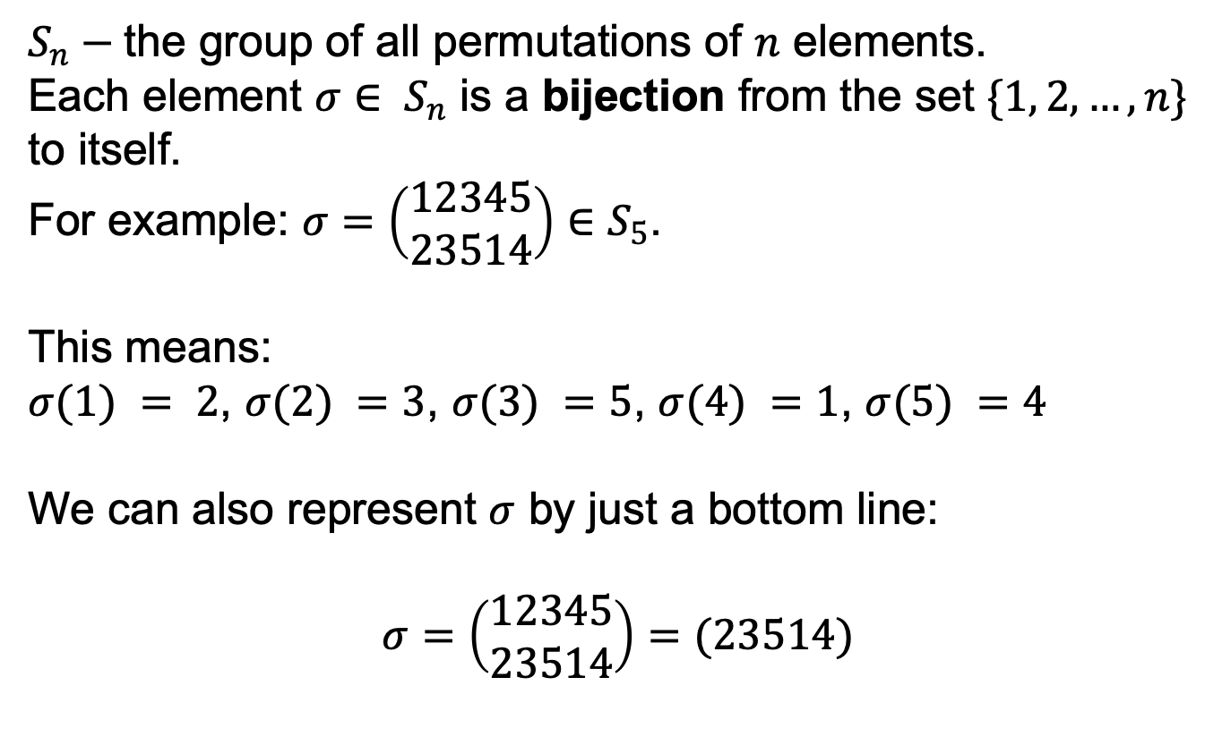
Representation theory
$S_{n}−$the group of all permutations of $n$ elements.
Each element $σ∈ S_{n}$ is a bijection from the set $\{1, 2, …, n\}$ to itself.
For example: $σ=\left(\begin{aligned}12345 \\ 23514\end{aligned}\right)∈S_{5}$.
This means:
$σ(1) = 2$, $σ(2) =3$, $σ(3) =5$, $σ(4) =1$, $σ(5) =4$
We can also represent $σ$ by just a bottom line:
$$σ=\left(\begin{aligned}12345 \\ 23514\end{aligned}\right)=(23514)$$

Slide 9
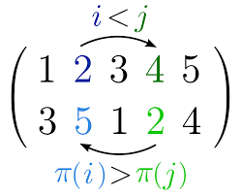
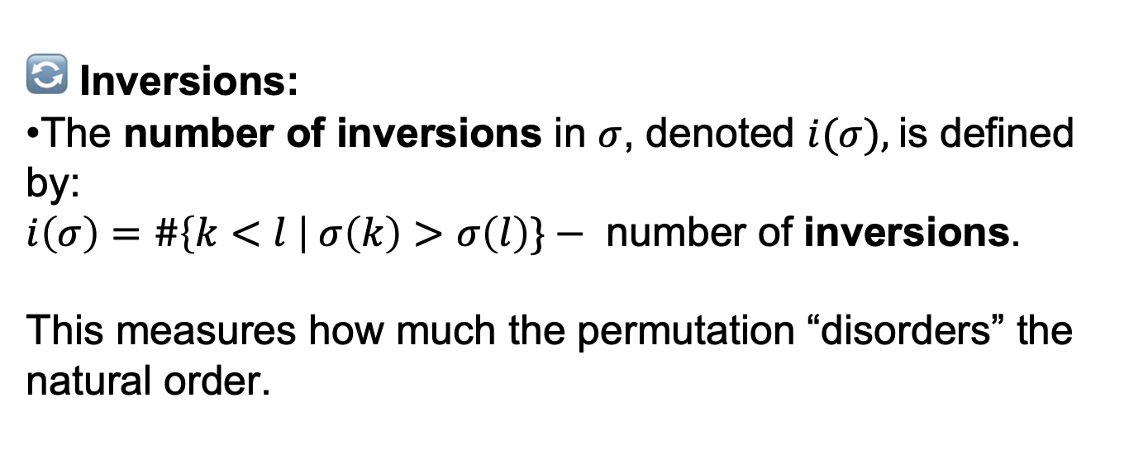
Representation theory
🔄 Inversions:
The number of inversions in $σ$, denoted $i(σ),$is defined by:
$i\left(σ\right)=\#\left\{k<l \right| σ\left(k\right)>σ\left(l\right)\}−$ number of inversions.
This measures how much the permutation “disorders” the natural order.

Slide 10
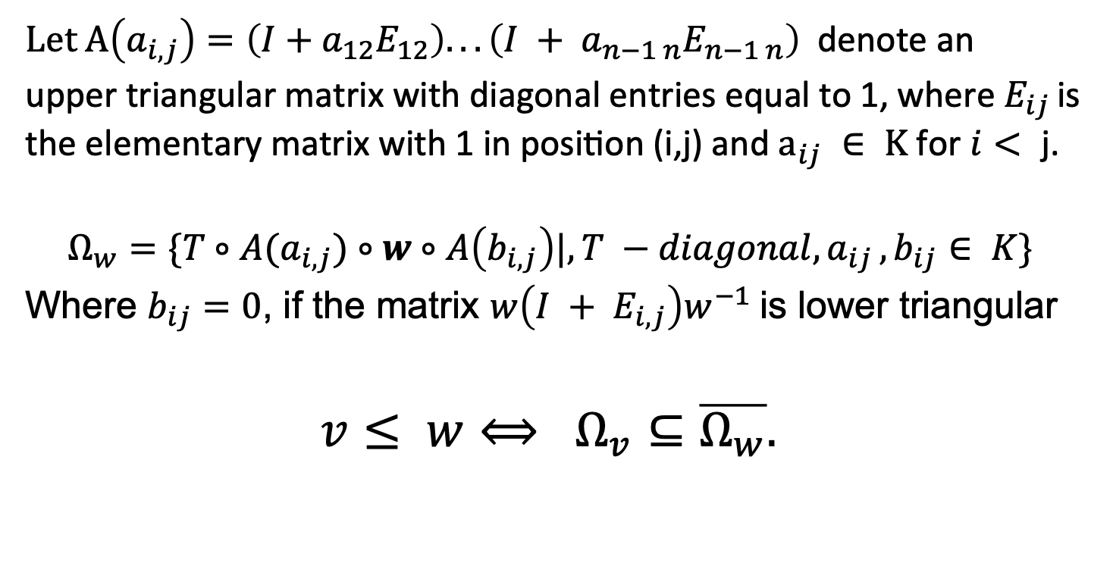
Bruhat Order Motivation
Let $A\left(a_{i,j}\right)=\left(I+a_{12}E_{12}\right). . . \left(I + a_{n−1 n}E_{n−1 n}\right) \text{denote} \text{an}$
$\text{upper} \text{triangular} \text{matrix} \text{with} \text{diagonal} \text{entries} \text{equal} \text{to}\text{ 1, }\text{where}{ E}_{ij }\text{is} \text{the} \text{elementary} \text{matrix} \text{with}\text{ 1 }\text{in} \text{position}\text{ (}\text{i}\text{,}\text{j}\text{) }\text{and} a_{ij} ∈ K \text{for} i< \text{j}\text{.}$
$$Ω_{w}=\{T∘A(a_{i,j})∘w∘A\left(b_{i, j}\right)|{, T −diagonal, a}_{ij},b_{ij}∈ K\}$$
Where $b_{ij}=0$, if the matrix $w\left(I + E_{i, j}\right)w^{−1}$is lower triangular
$$v≤ w⟺ Ω_{v}⊆\overline{Ω_{w}}.$$

Slide 11
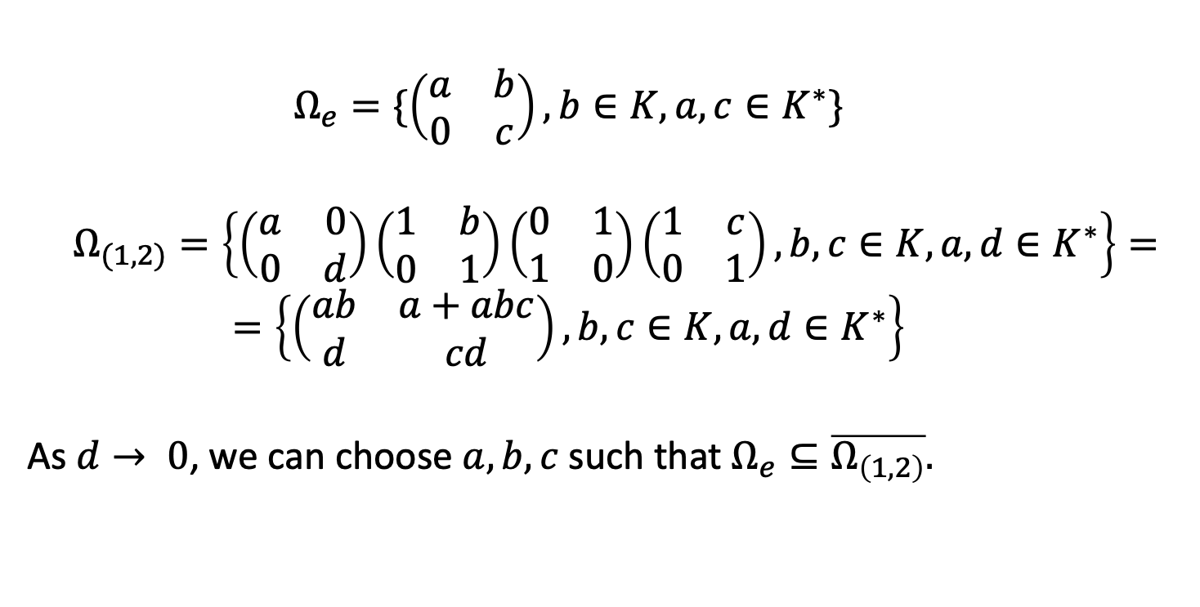

Example in $GL_{2}$
$$Ω_{e}=\{\left(\begin{matrix}a & b \\ 0 & c\end{matrix}\right), b∈K, a,c∈K^{∗}\}$$
$$Ω_{(1,2)}=\left\{\left(\begin{matrix}a & 0 \\ 0 & d\end{matrix}\right)\left(\begin{matrix}1 & b \\ 0 & 1\end{matrix}\right)\left(\begin{matrix}0 & 1 \\ 1 & 0\end{matrix}\right)\left(\begin{matrix}1 & c \\ 0 & 1\end{matrix}\right), b,c∈K, a,d∈K^{∗}\right\}=$$
$$=\left\{\left(\begin{matrix}ab & a+abc \\ d & cd\end{matrix}\right), b,c∈K, a,d∈K^{∗}\right\}$$
As $d→ 0$, we can choose $a, b, c$such that $Ω_{e}⊆\overline{Ω_{\left(1,2\right)}}.$

Slide 12
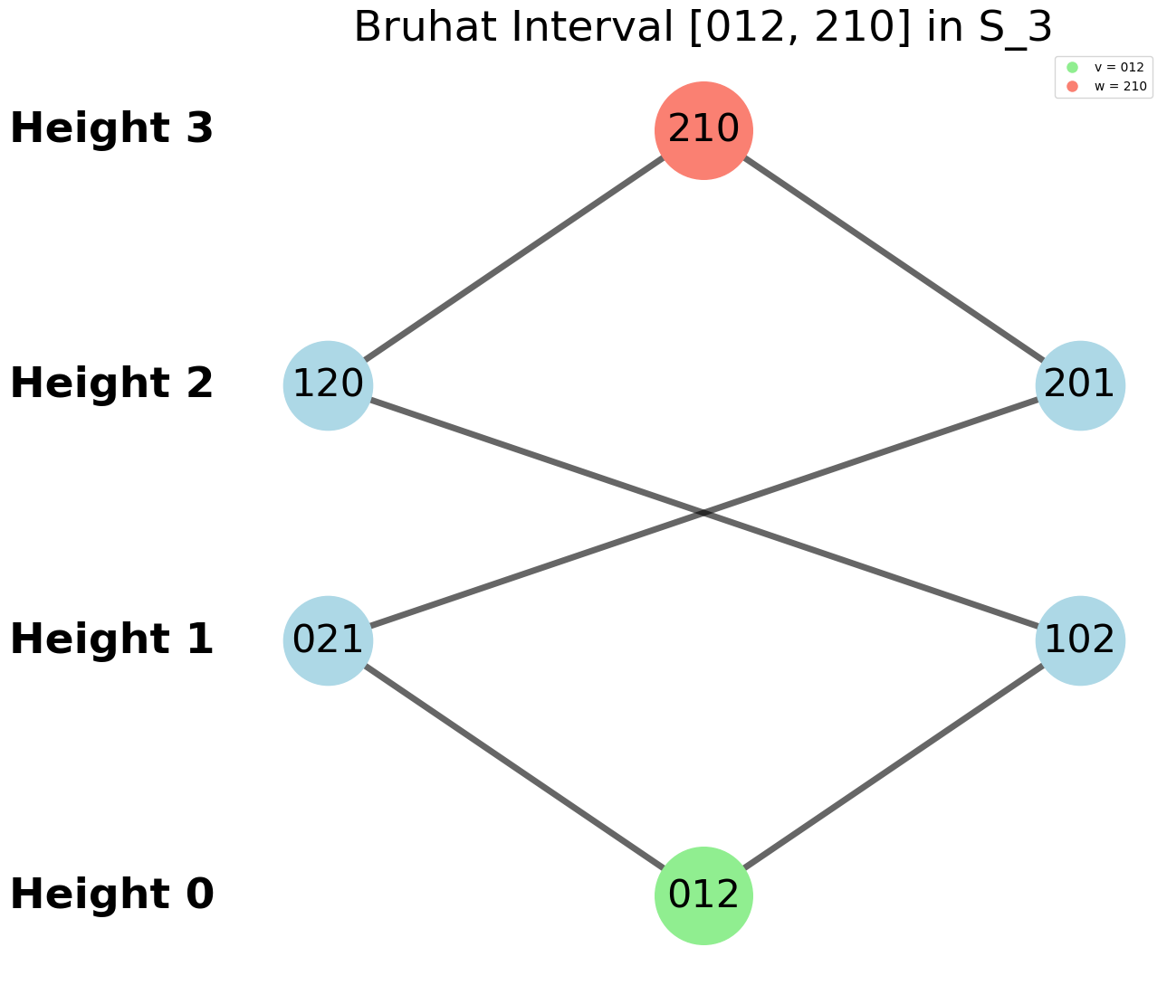
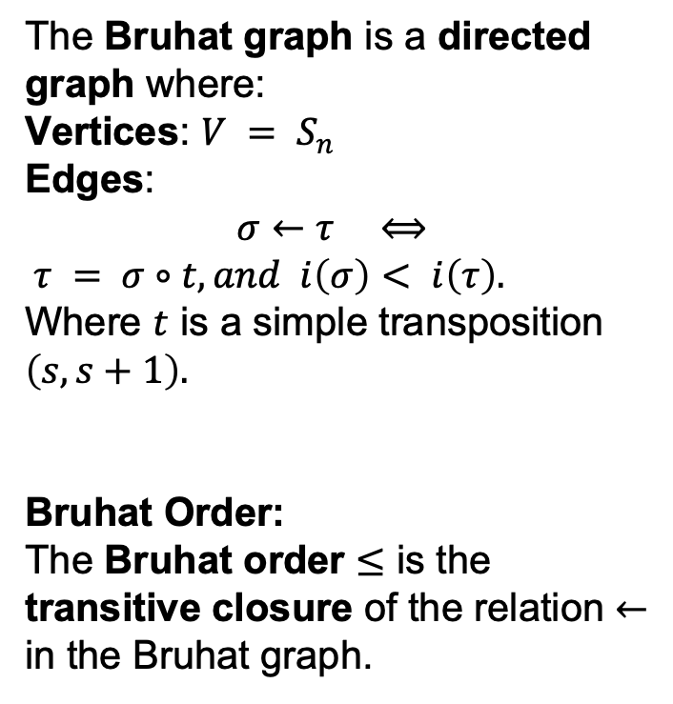
Representation theory
The Bruhat graph is a directed graph where:
Vertices: $V = S_{n}$
Edges:
$$σ←τ ⟺$$
$τ = σ∘t, and i\left(σ\right)< i\left(τ\right).$
Where $t$ is a simple transposition $\left(s, s+1\right).$
Bruhat Order:
The Bruhat order $≤$ is the transitive closure of the relation $←$ in the Bruhat graph.

Slide 13
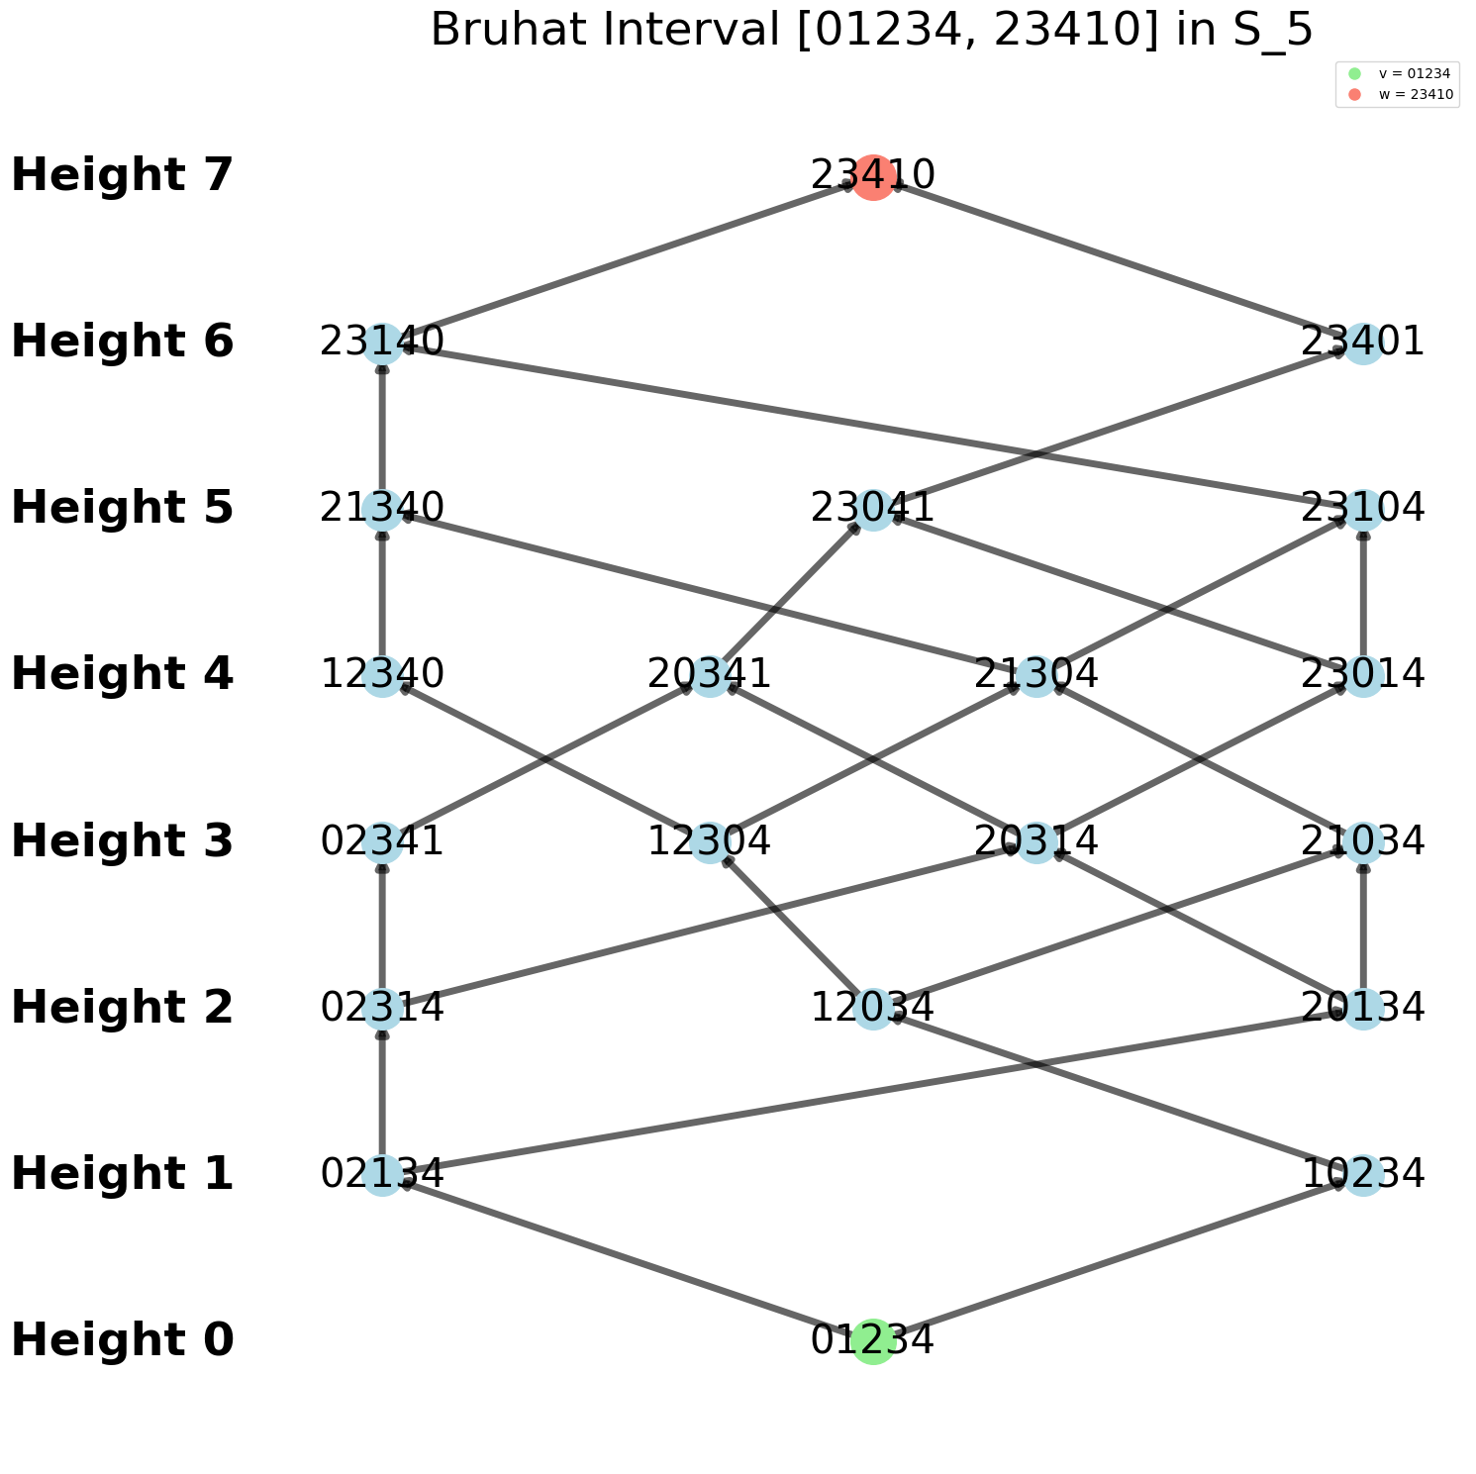
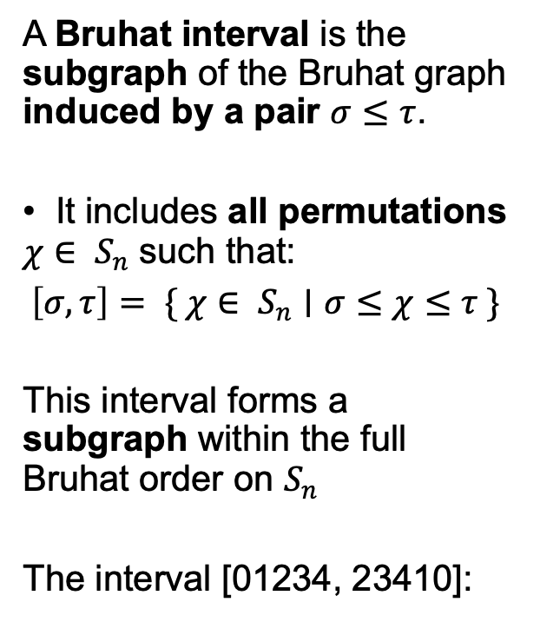
Representation theory
A Bruhat interval is the subgraph of the Bruhat graph induced by a pair $σ≤τ$.
It includes all permutations $χ∈ S_{n}$ such that:
$$\left[σ, τ\right]= \{ χ∈ S_{n}∣σ≤χ≤τ \}$$
This interval forms a subgraph within the full Bruhat order on $S_{n}$
The interval [01234, 23410]:

Slide 14
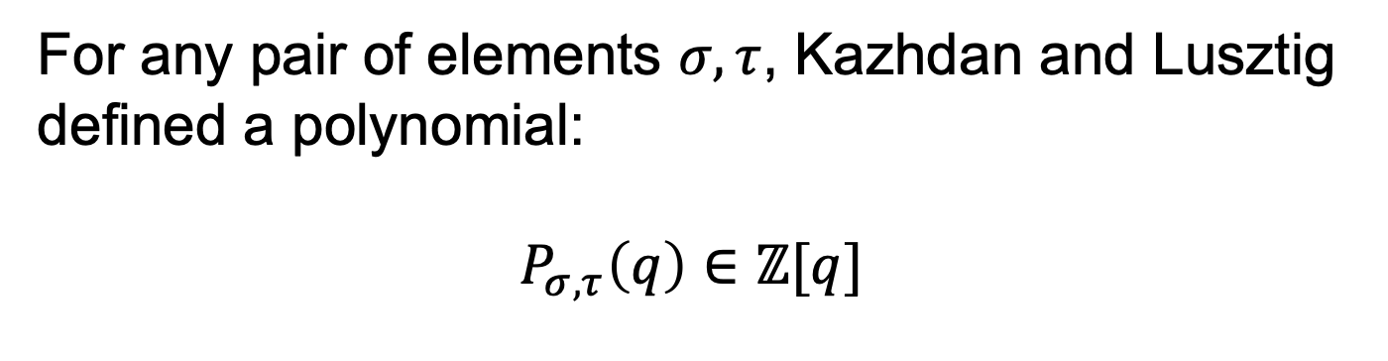
KL polynomials
For any pair of elements $σ, τ$, Kazhdan and Lusztig defined a polynomial:
$$P_{σ, τ}\left(q\right)∈ℤ[q]$$
Defined inductively, starting from the identity element. At each step, the computation may depend on previously calculated polynomials. Arise from Hecke algebra theory.

Slide 15
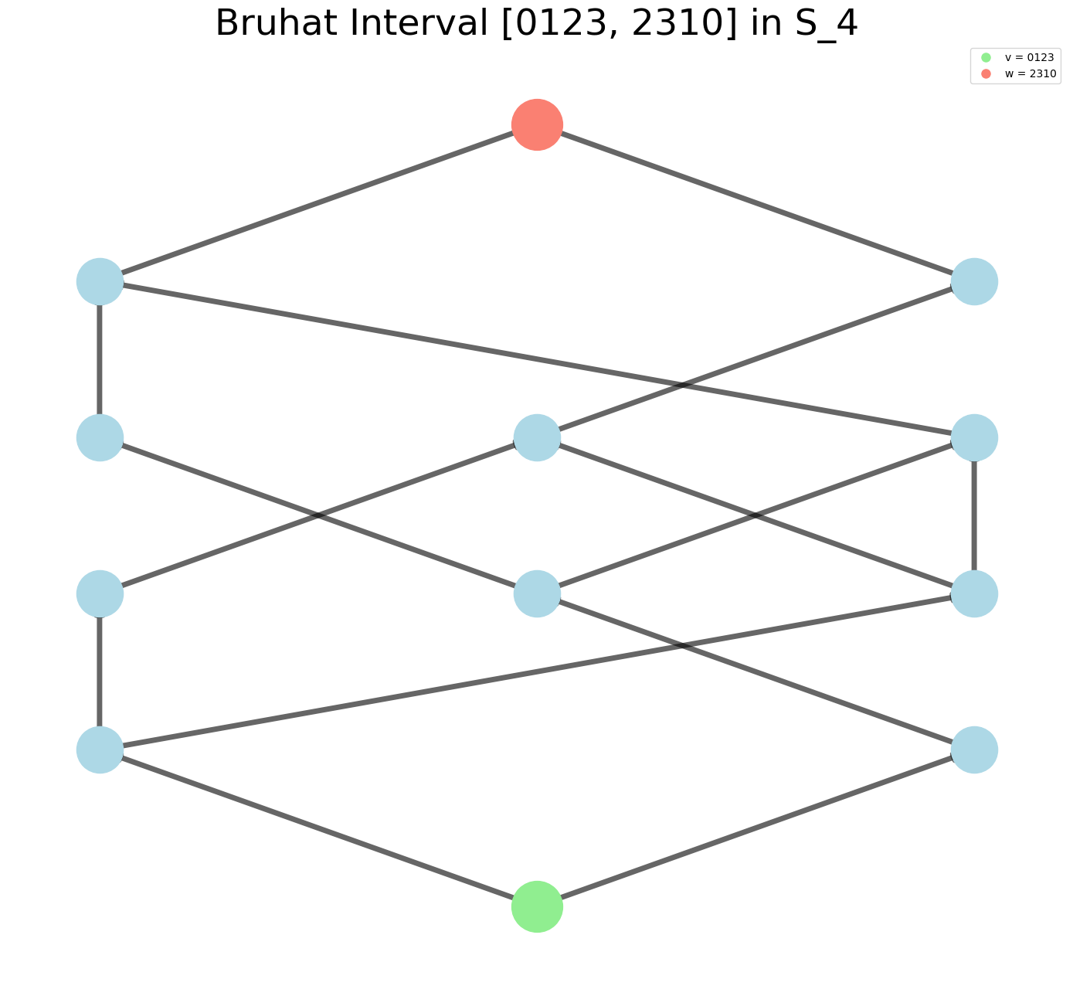
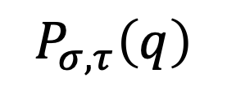
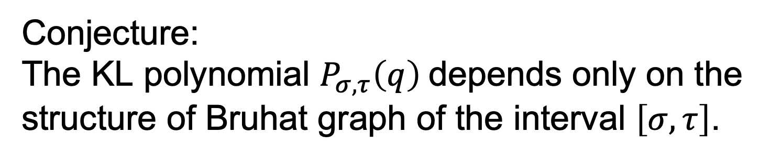
Combinatorial Invariance Conjecture
Conjecture:
The KL polynomial $P_{σ, τ}\left(q\right)$depends only on the structure of Bruhat graph of the interval $\left[σ, τ\right]$.
$$P_{σ, τ}\left(q\right)$$

Slide 16
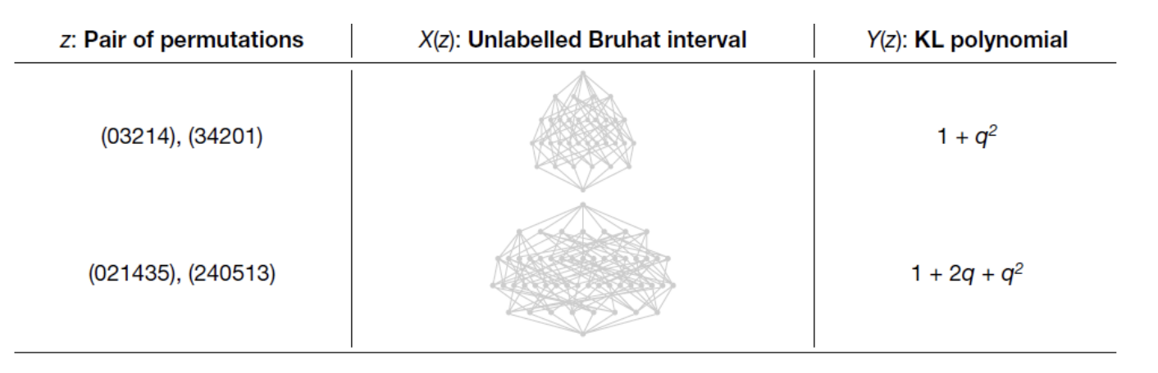
Combinatorial Invariance Conjecture

Slide 17
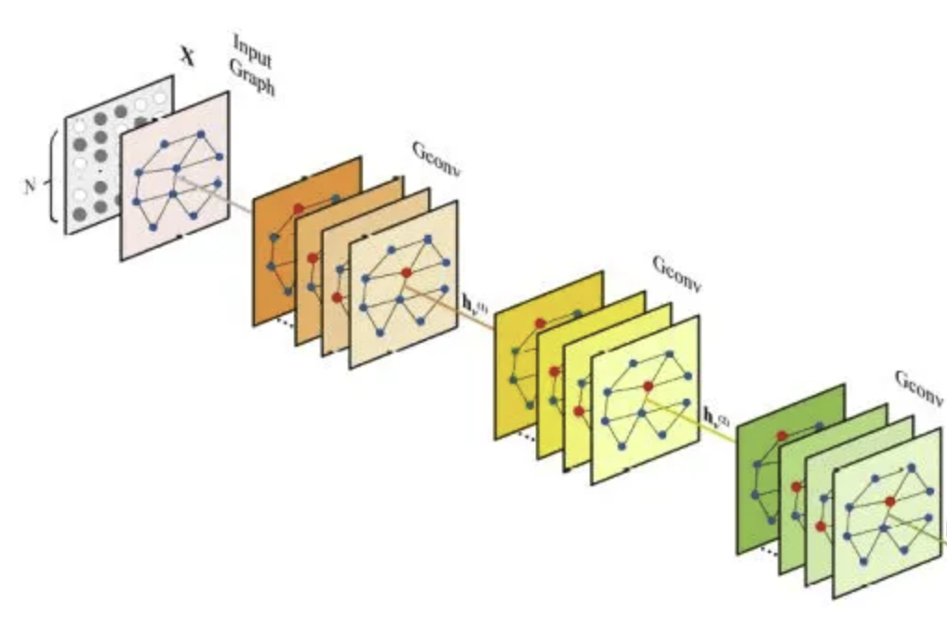
Graph Neural Network

Slide 18
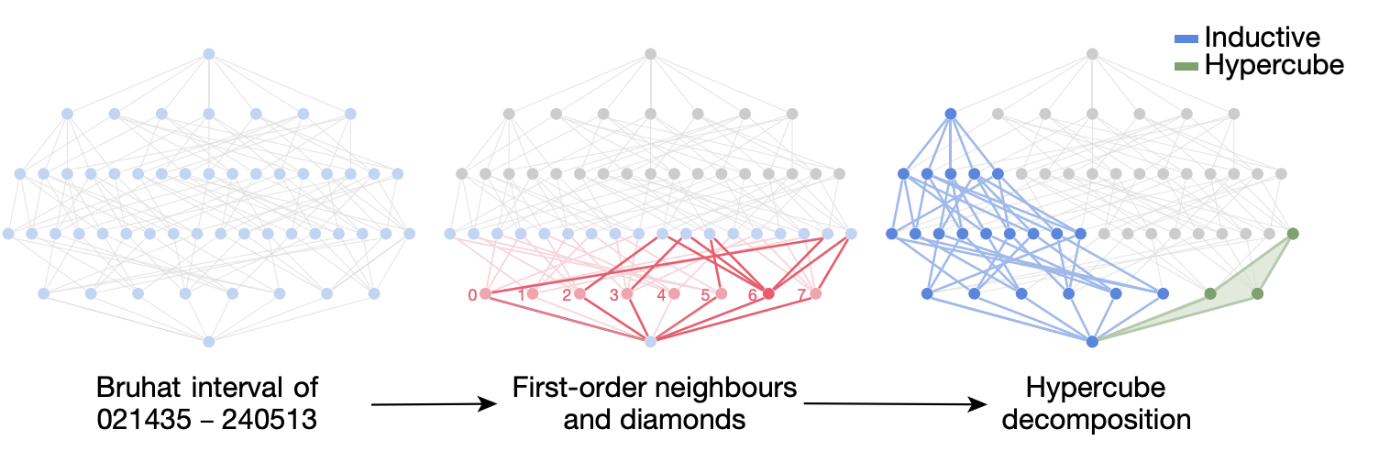
Combinatorial Invariance Conjecture
A neural network was trained to compute Kazhdan–Lusztig polynomials for labeled Bruhat intervals.
The network achieved high accuracy, uncovering interesting structure in the input data.
Main Theorem (Conjectured & Proved):
Every labeled Bruhat interval admits a canonical hypercube decomposition along its extremal reflections?, from which the KL polynomial can be directly computed.

Slide 19
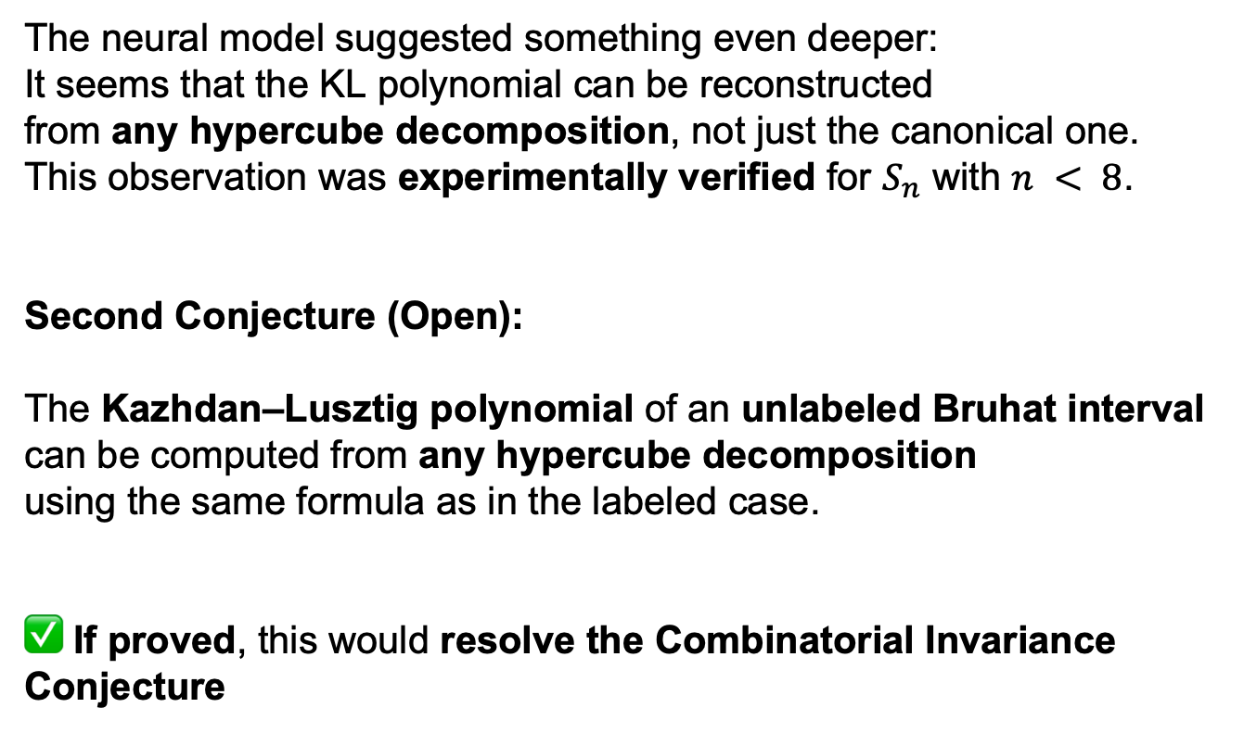
Combinatorial Invariance Conjecture
The neural model suggested something even deeper:
It seems that the KL polynomial can be reconstructed
from any hypercube decomposition, not just the canonical one.
This observation was experimentally verified for $S_{n}$ with $n < 8$.
Second Conjecture (Open):
The Kazhdan–Lusztig polynomial of an unlabeled Bruhat interval
can be computed from any hypercube decomposition
using the same formula as in the labeled case.
✅ If proved, this would resolve the Combinatorial Invariance Conjecture

Slide 20
Advancing mathematics by guiding human intuition with AI (2021)
Knot theory
Representation
theory
Knot Theory

Slide 21
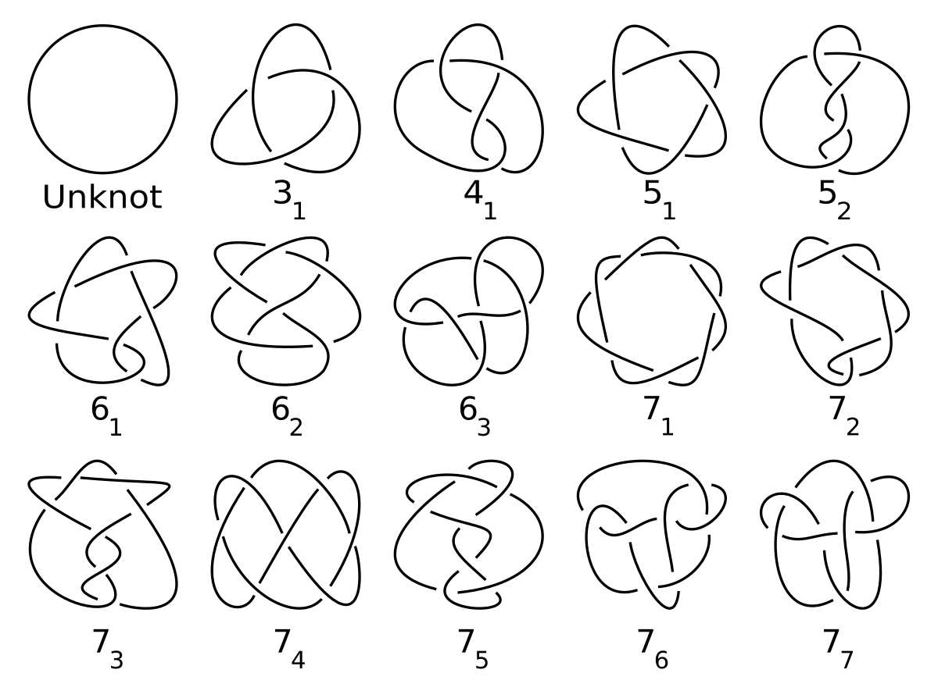
Knot Theory

Slide 22

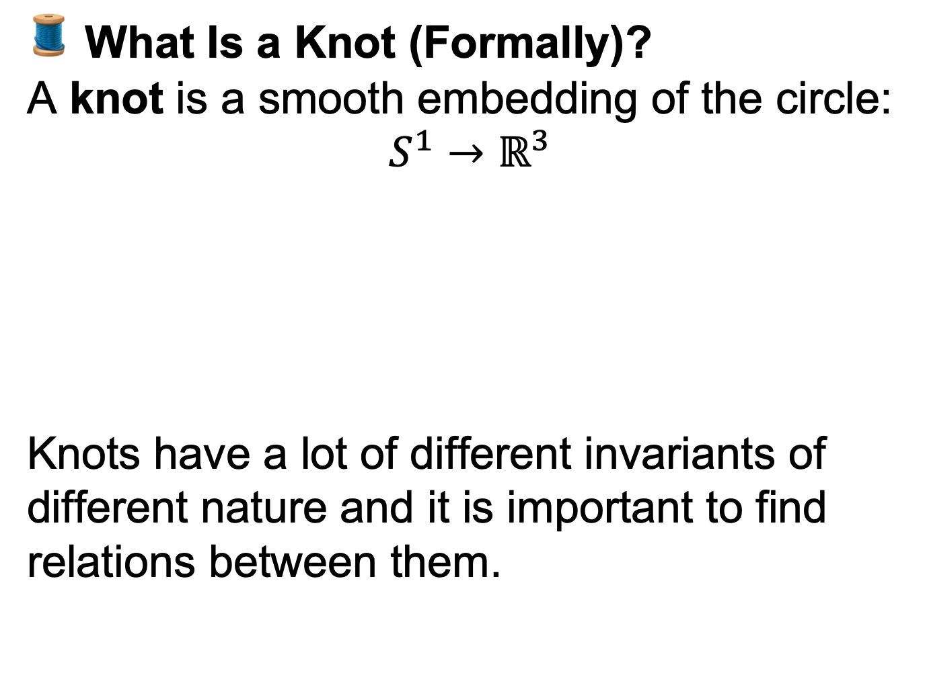
Knot Theory
🧵 What Is a Knot (Formally)?
A knot is a smooth embedding of the circle:
$$S^{1}→ℝ^{3}$$
Knots have a lot of different invariants of different nature and it is important to find relations between them.

Slide 23
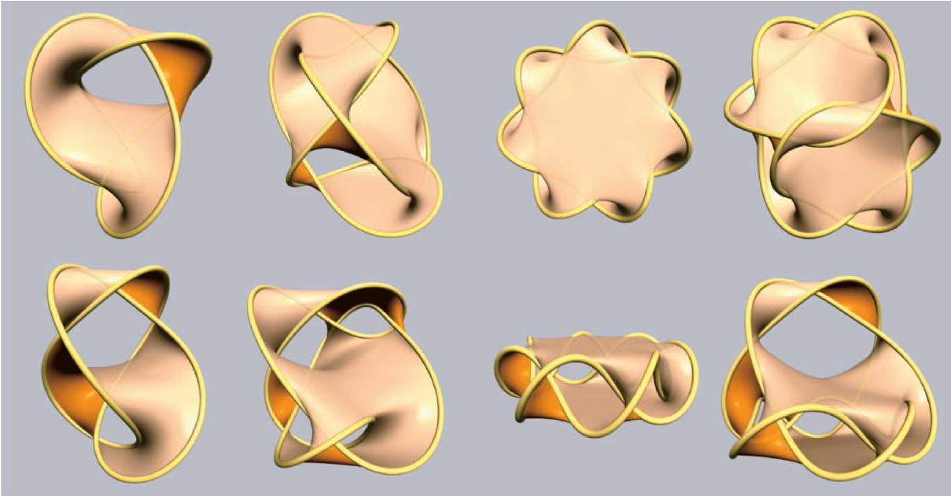
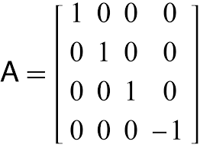
Knot Theory
🧬 What is the Signature of a Knot?
We can construct a Seifert surface — a smooth, oriented surface whose boundary is the knot.
From this surface, we build a matrix called the Seifert matrix, using information from the surface’s homology.
The signature of the knot is defined as the signature of this matrix (i.e., the number of positive eigenvalues minus the number of negative ones).
✅ Key Point
The signature is a knot invariant — it stays the same no matter which Seifert surface is used.

Slide 24
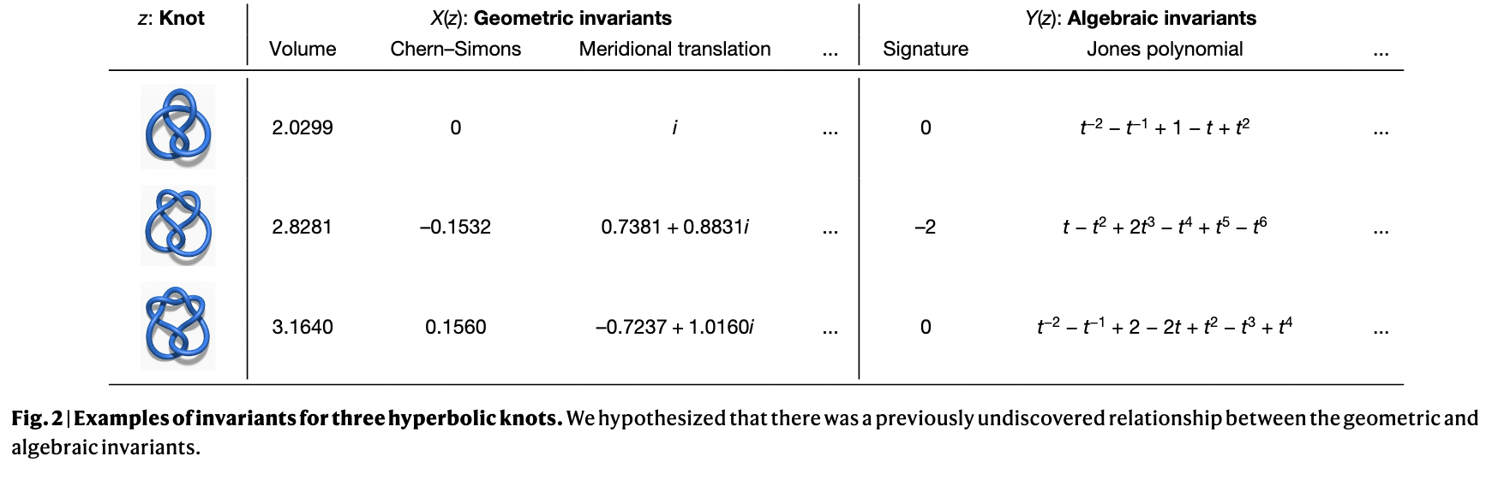
Knot Theory
🎯 Goal of the Study
The authors aim to explore whether there exists a hidden relationship between algebraic and geometric knot invariants.
Specifically, they focus on predicting the signature of a knot — an algebraic invariant — using geometric features of the knot.
We’ll see how they approached this problem in today’s notebook!

Slide 25
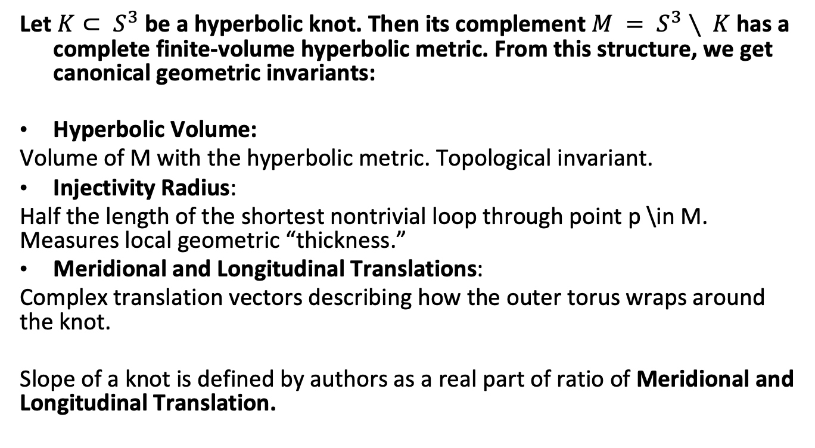
Geometric Invariants
Let $K⊂ S^{3}$ be a hyperbolic knot. Then its complement $M = S^{3}∖ K$has a complete finite-volume hyperbolic metric. From this structure, we get canonical geometric invariants:
Hyperbolic Volume:
Volume of M with the hyperbolic metric. Topological invariant.
Injectivity Radius:
Half the length of the shortest nontrivial loop through point p \in M. Measures local geometric “thickness.”
Meridional and Longitudinal Translations:
Complex translation vectors describing how the outer torus wraps around the knot.
Slope of a knot is defined by authors as a real part of ratio of Meridional and Longitudinal Translation.

Slide 26
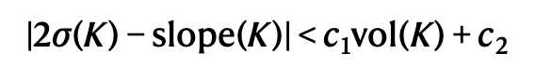
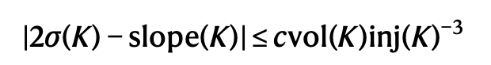
Knot Theory
By applying machine learning techniques, the authors initially formulated an incorrect mathematical hypothesis:
by analyzing the behavior of counterexamples, they were able to refine their understanding — ultimately leading to an updated hypothesis, which they then proved:

